Slide 1
SISTEM HOTEL
Cryan Fajri
Fais Dika
Rafli Haryadi
Programmer
Teknisi
Analisis

Slide 2
Latar Belakang
01
Hobi
Karena Fais dika sering bepergian hotel.
02
Mudah
Mudah untuk dibuat alurnya
03
Kebutuhan
Kesulitan orang lain dalam membooking hotel

Slide 3
Tujuan
Mempermudah Dalam Membooking Hotel, Secara Online
Membuat Profil WEB Dari Hotel Tersebut
Memberikan Harga Murah Dengan Fasilitas Yang Terbaik

Slide 4
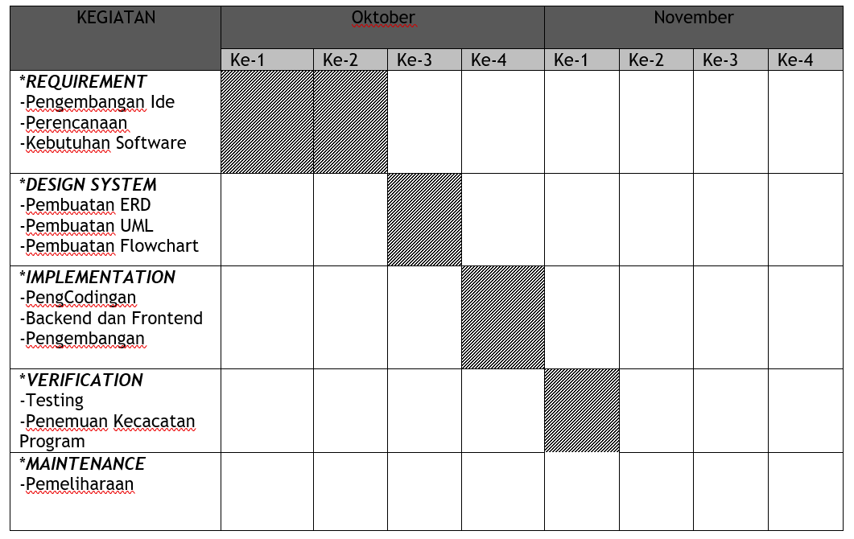
Gantt Chart

Slide 5
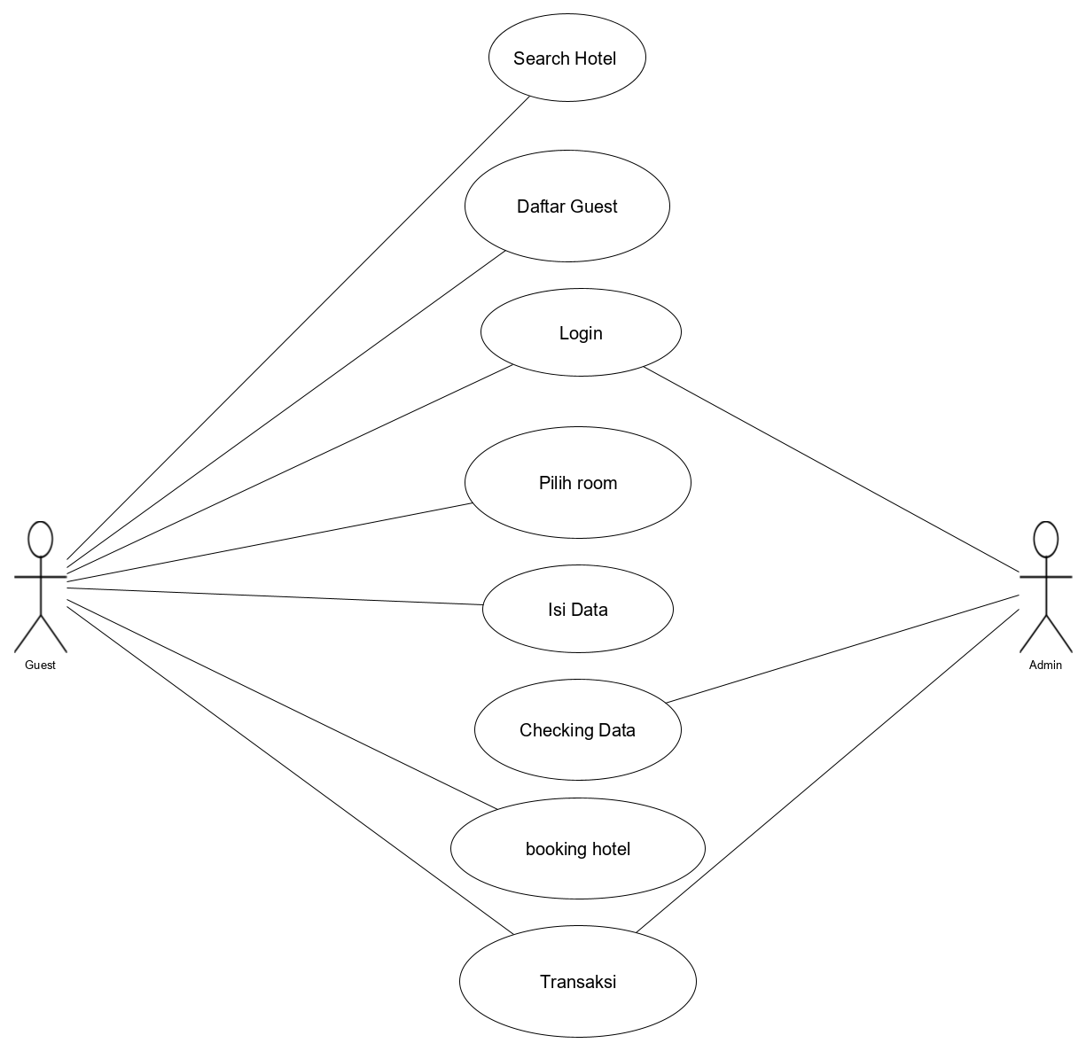
DFD / UML

Slide 6
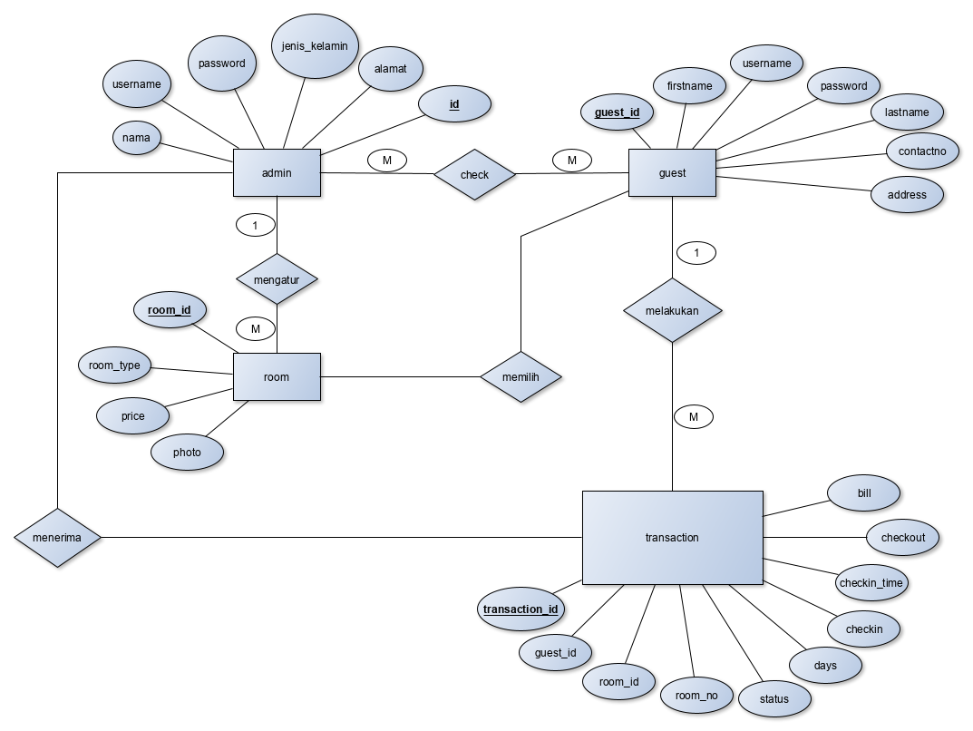
ERD

Slide 7
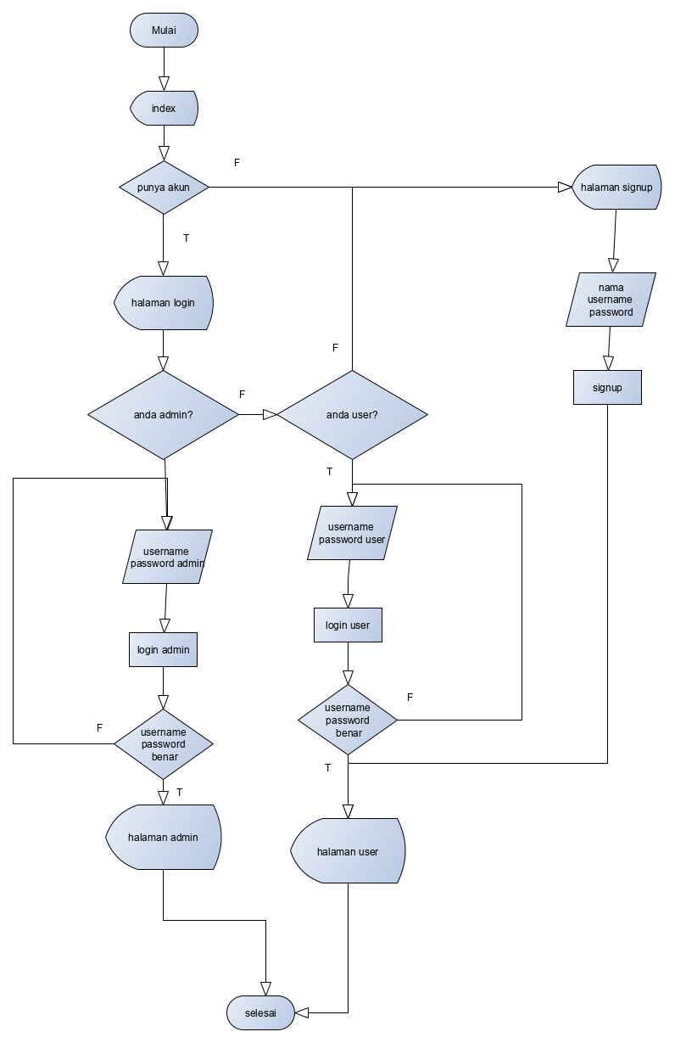
Flowchart

Slide 8
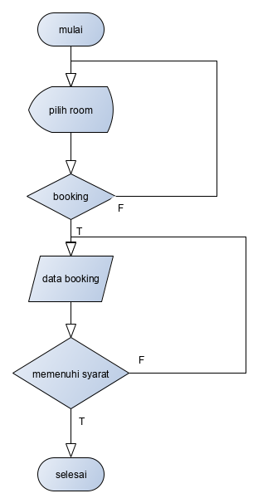

Slide 9
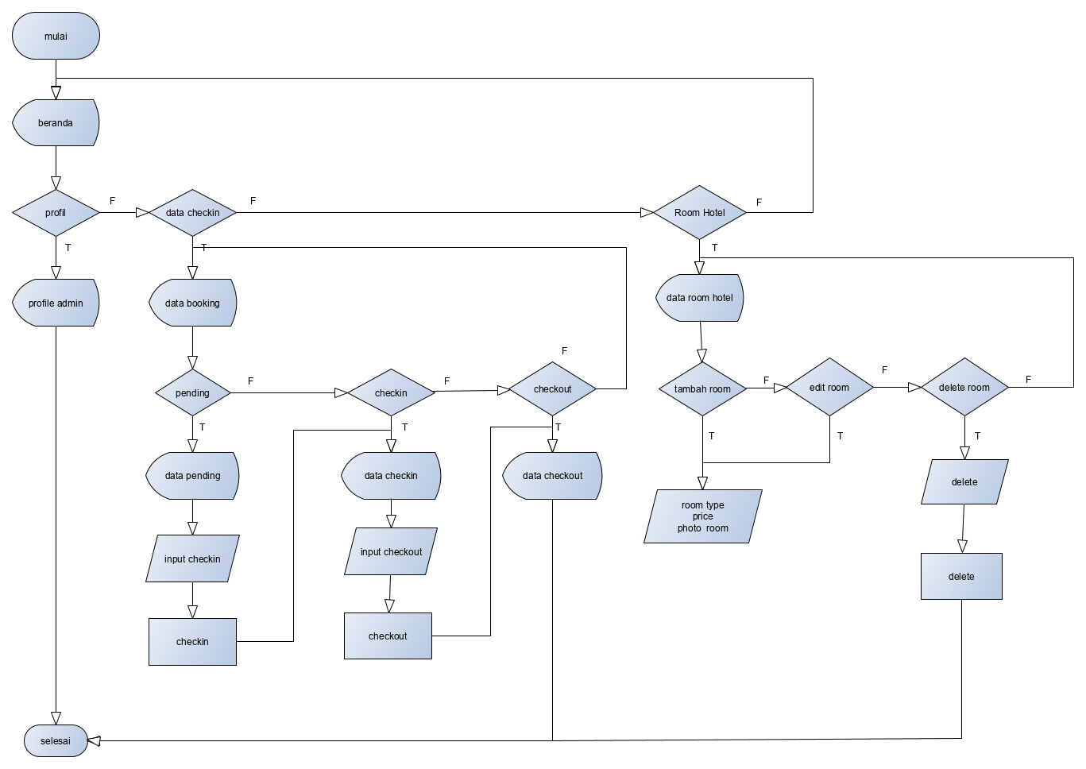
ADMIN

Slide 10
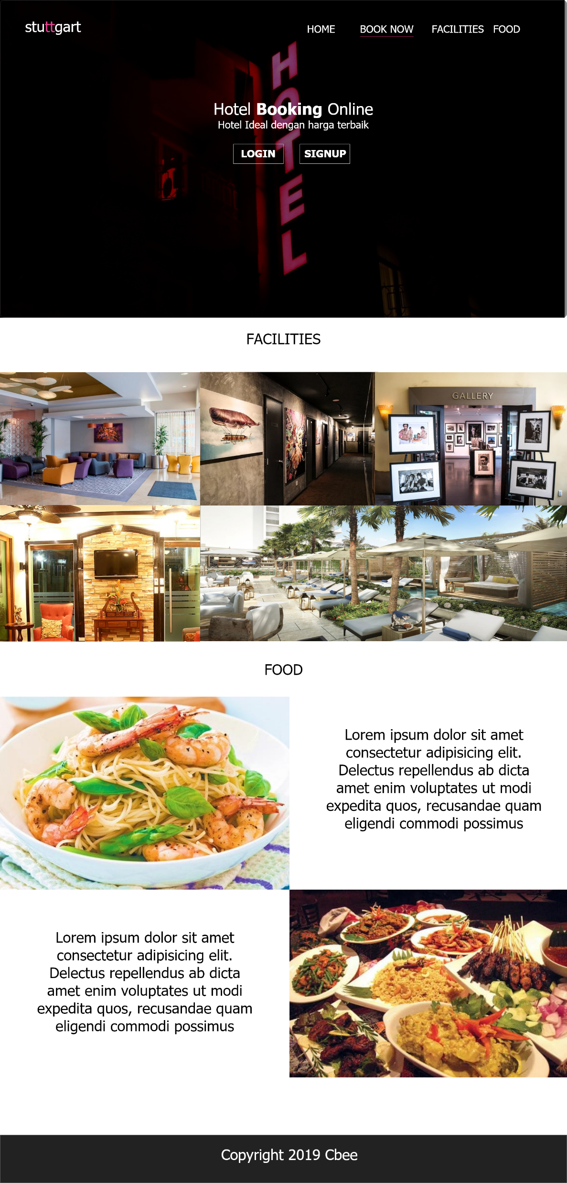
Mockup

Slide 11
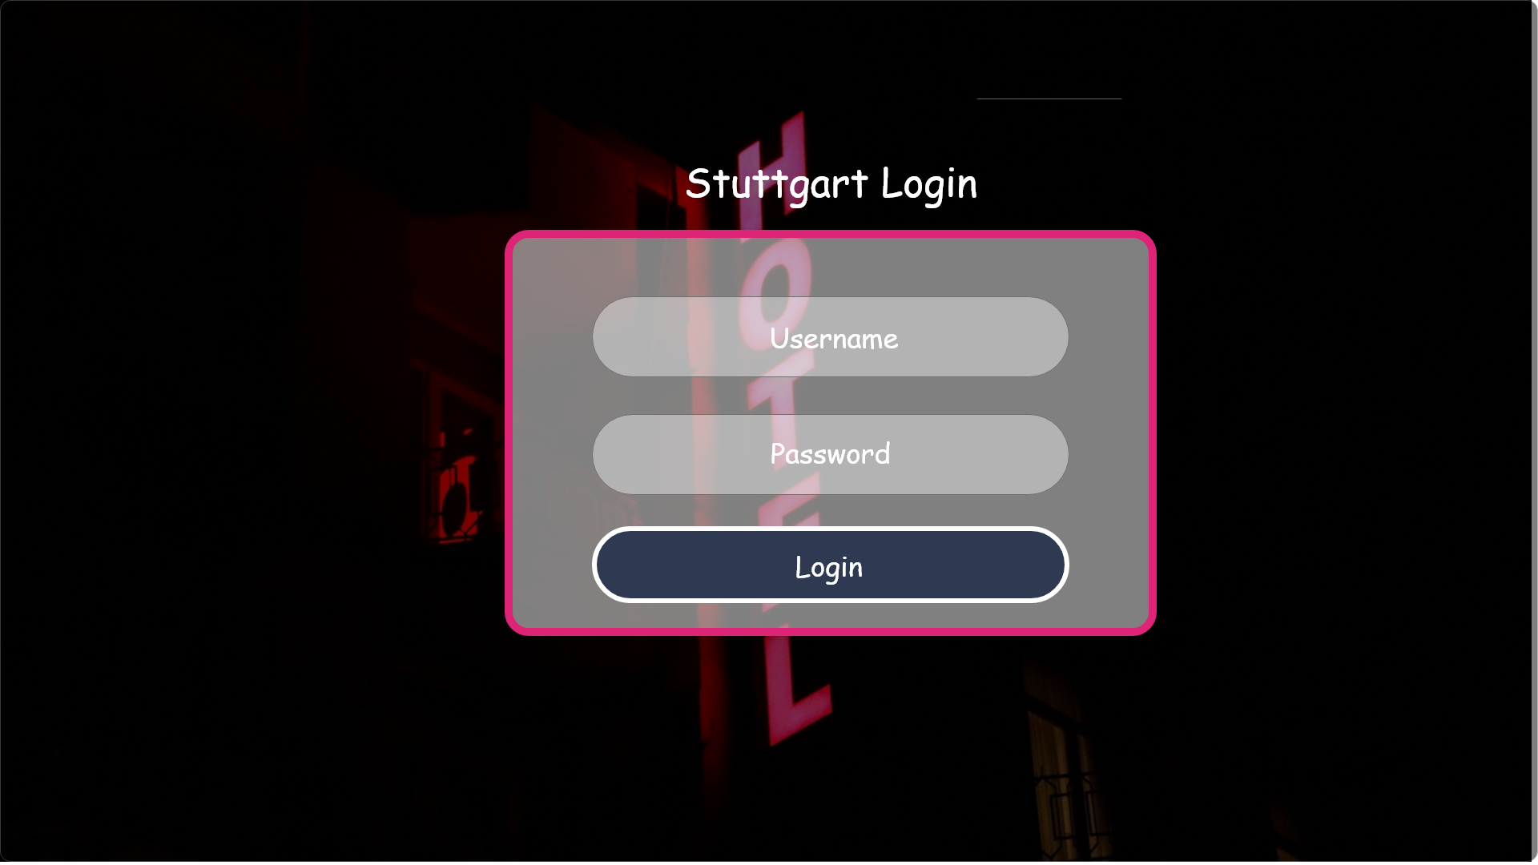
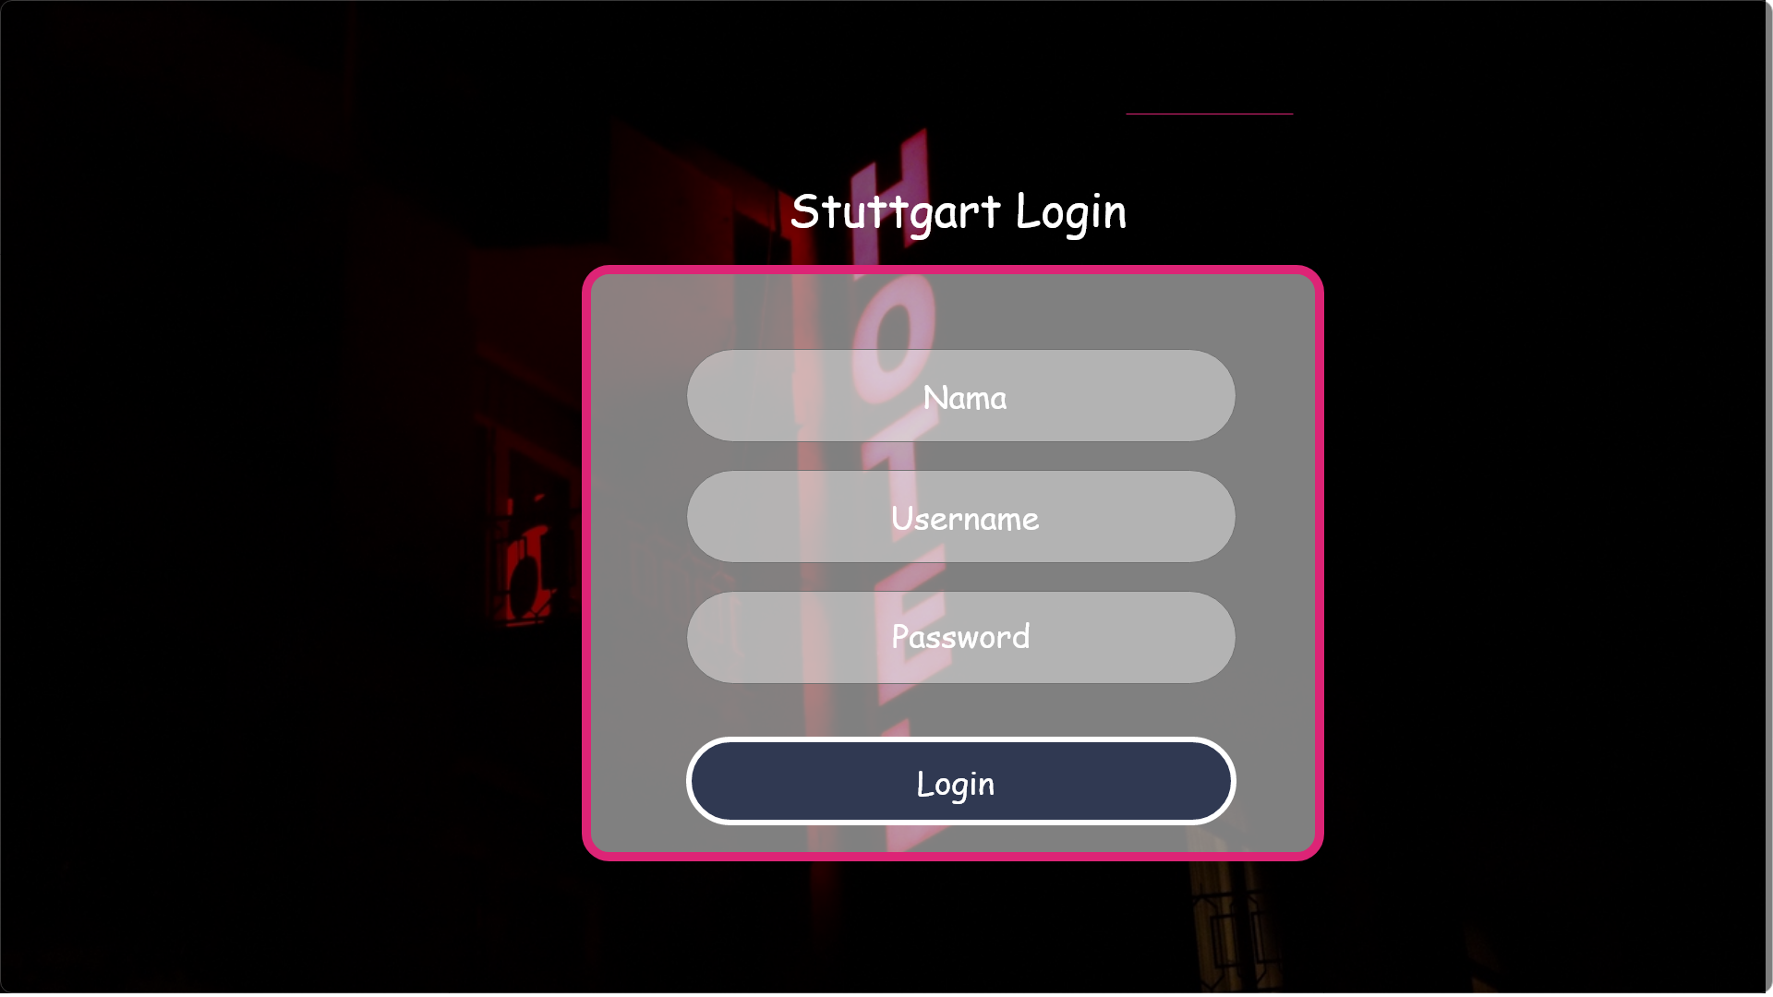
SIGN UP FORM
LOGIN FORM

Slide 12


Slide 13
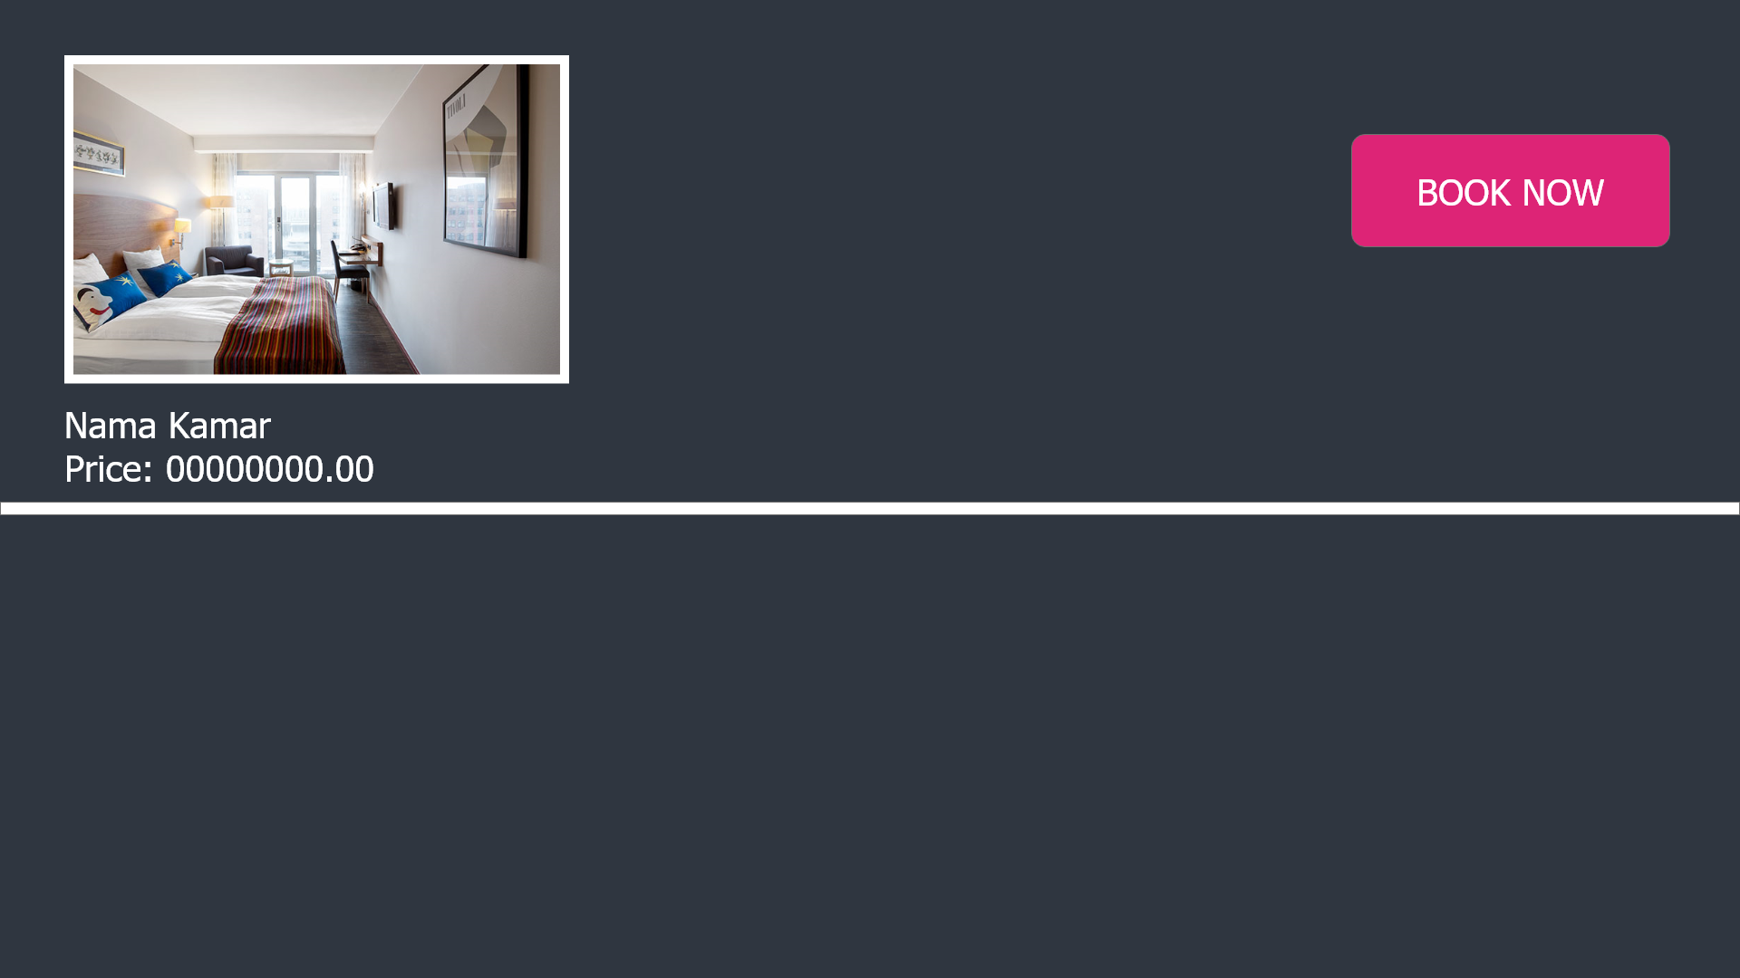

Slide 14
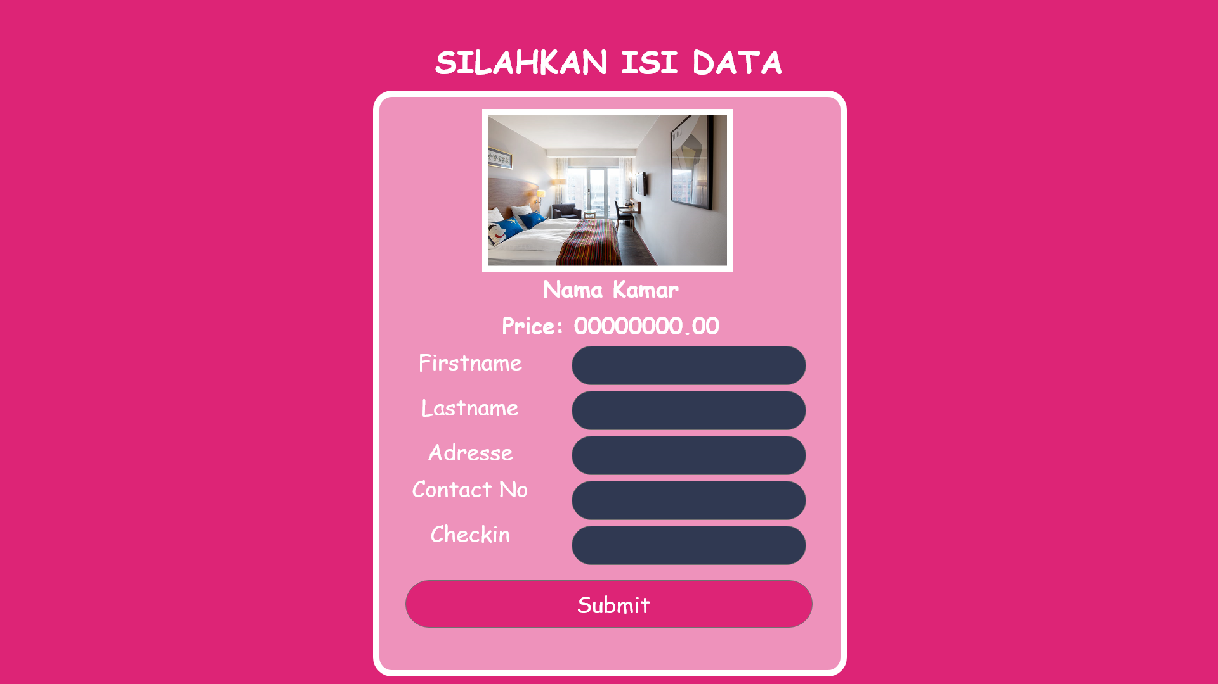

Slide 15
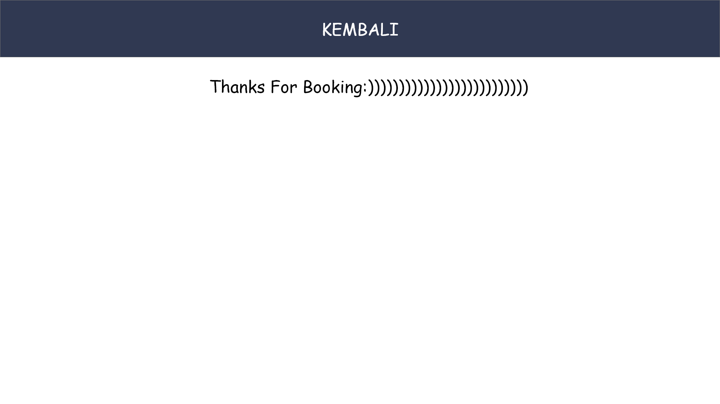

Slide 16
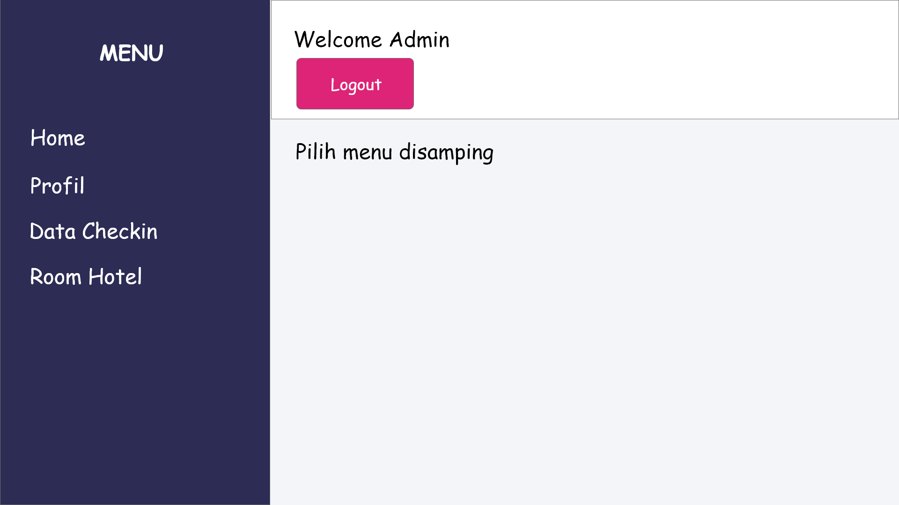

Slide 17
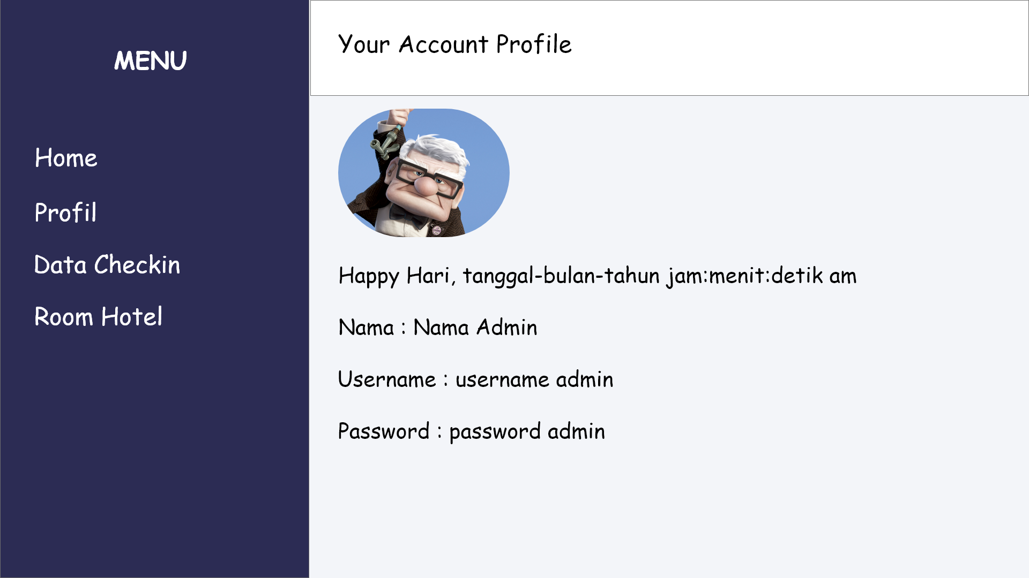

Slide 18
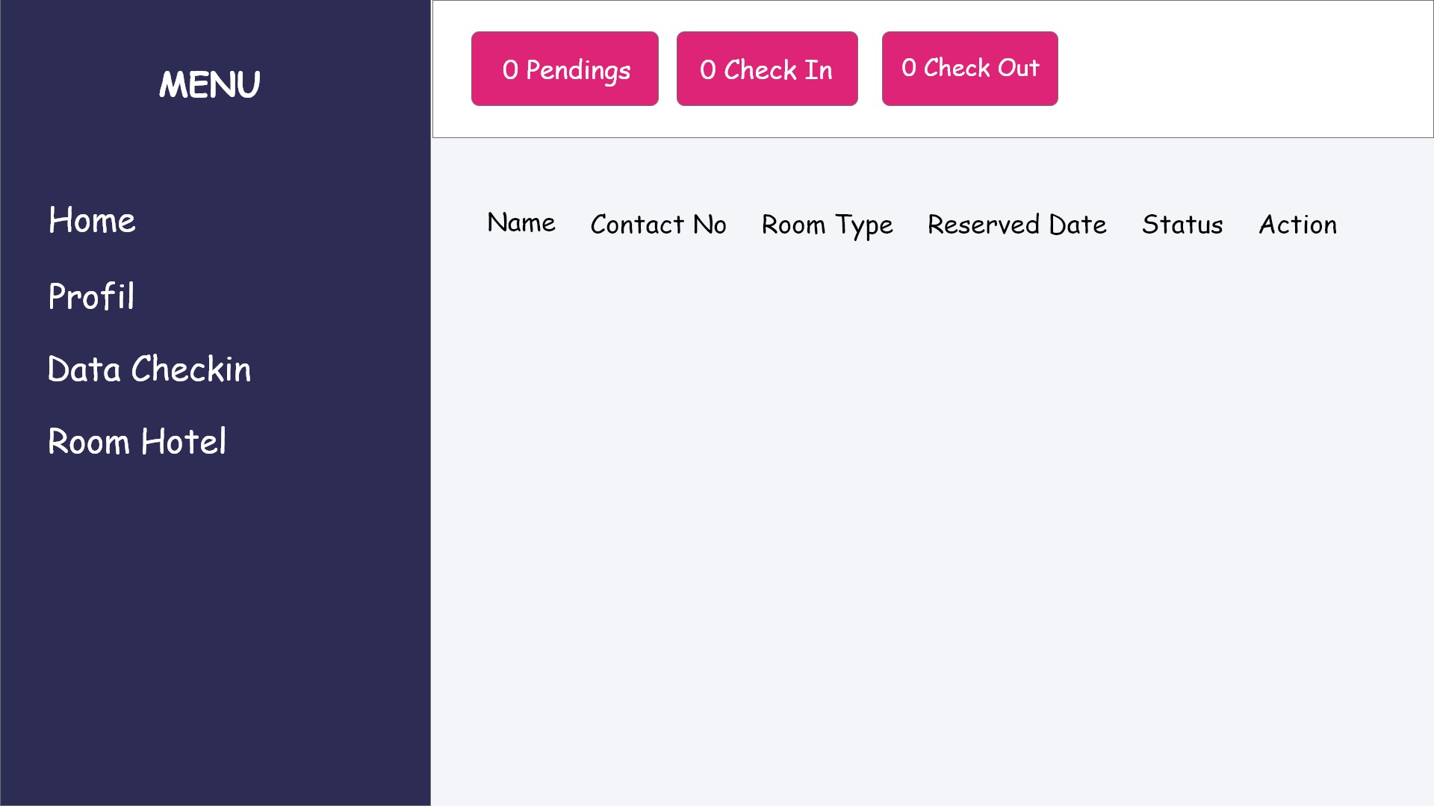
We Create
Quality Professional
PPT Presentation
You can simply impress your audience and add a unique zing and appeal to your Presentations. Get a modern PowerPoint Presentation that is beautifully designed. I hope and I believe that this Template will your Time, Money and Reputation. You can simply impress your audience and add a unique zing and appeal to your Presentations.
Get a modern PowerPoint Presentation that is beautifully designed.

Slide 19
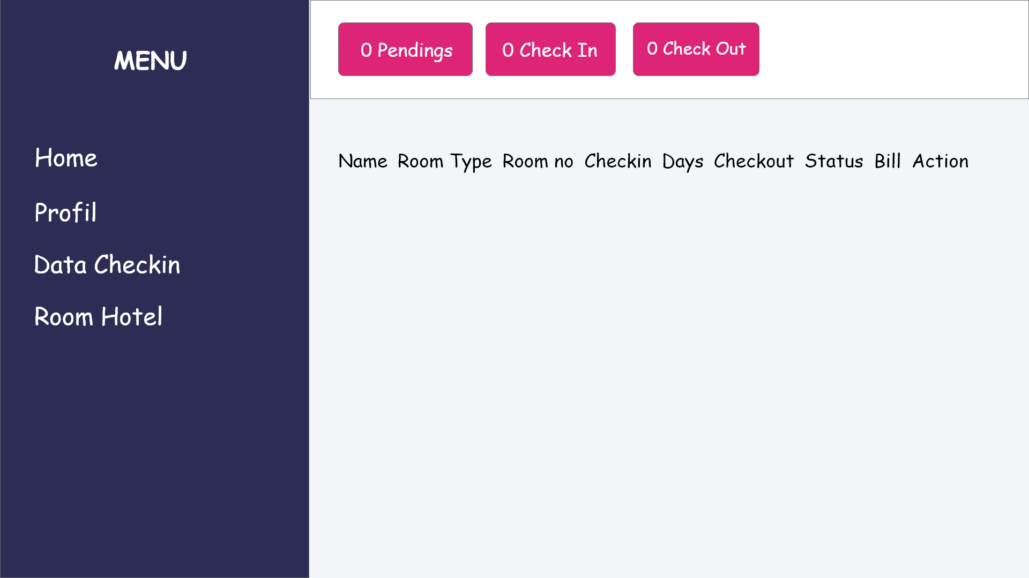
Infographic Style
Content Here
You can simply impress your audience and add a unique zing and appeal to your Presentations. Easy to change colors, photos and Text.
Content Here
You can simply impress your audience and add a unique zing and appeal to your Presentations. Easy to change colors, photos and Text.
Content Here
You can simply impress your audience and add a unique zing and appeal to your Presentations. Easy to change colors, photos and Text.
Content Here
You can simply impress your audience and add a unique zing and appeal to your Presentations. Easy to change colors, photos and Text.

Slide 20
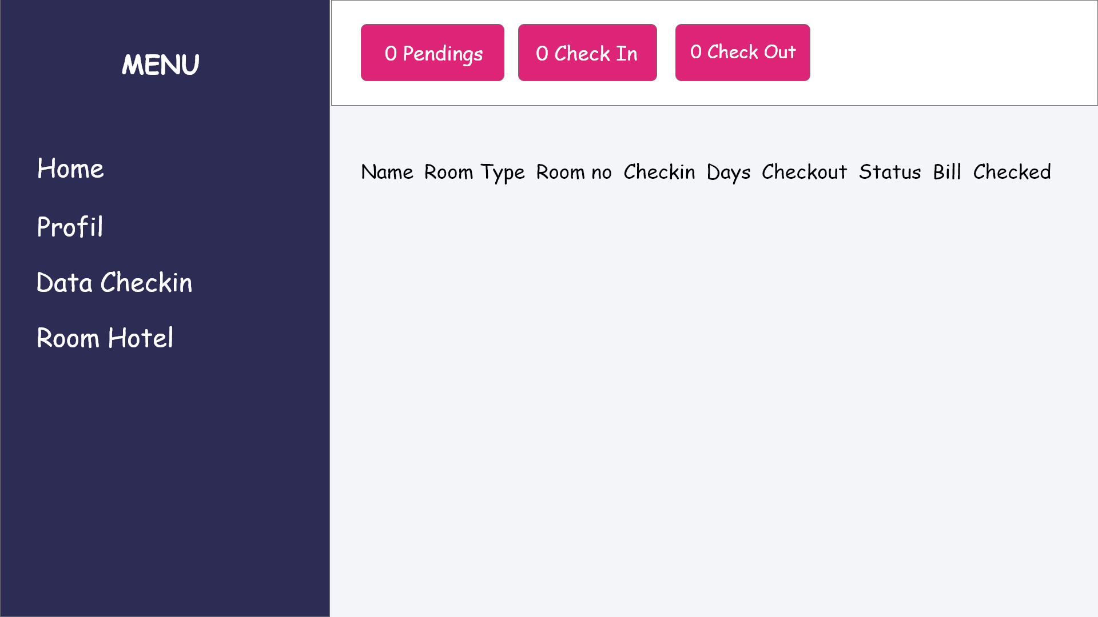
Infographic Style
Content Here
99%
You can simply impress your audience and add a unique zing and appeal to your Presentations. Easy to change colors, photos and Text
Content Here
85%
You can simply impress your audience and add a unique zing and appeal to your Presentations. Easy to change colors, photos and Text
Content Here
67%
You can simply impress your audience and add a unique zing and appeal to your Presentations. Easy to change colors, photos and Text
Content Here
43%
You can simply impress your audience and add a unique zing and appeal to your Presentations. Easy to change colors, photos and Text

Slide 21
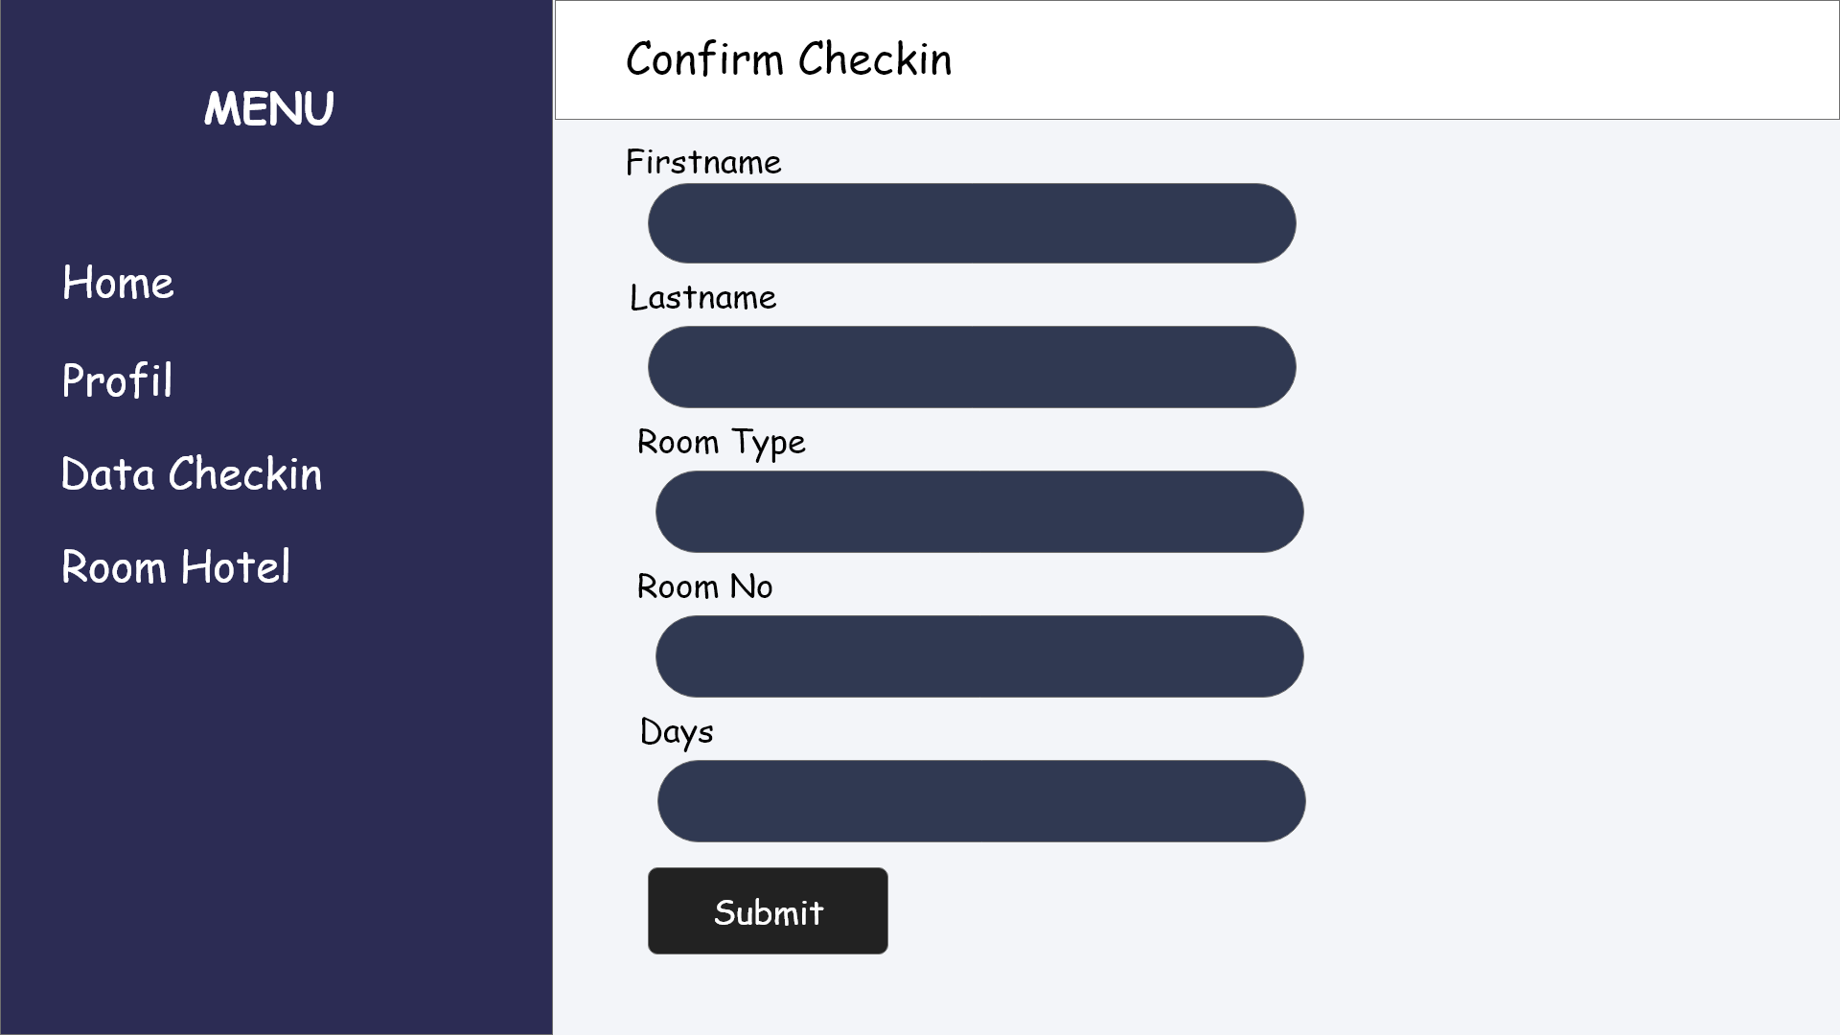
Infographic Style
ALLPPT Layout
Clean Text Slide
for your Presentation
You can simply impress your audience and add a unique zing and appeal to your Presentations. Get a modern PowerPoint Presentation that is beautifully designed. I hope and I believe that this Template will your Time, Money and Reputation. You can simply impress your audience and add a unique zing and appeal to your Presentations. Get a modern PowerPoint Presentation that is beautifully designed.
Get a modern PowerPoint Presentation that is beautifully designed.

Slide 22
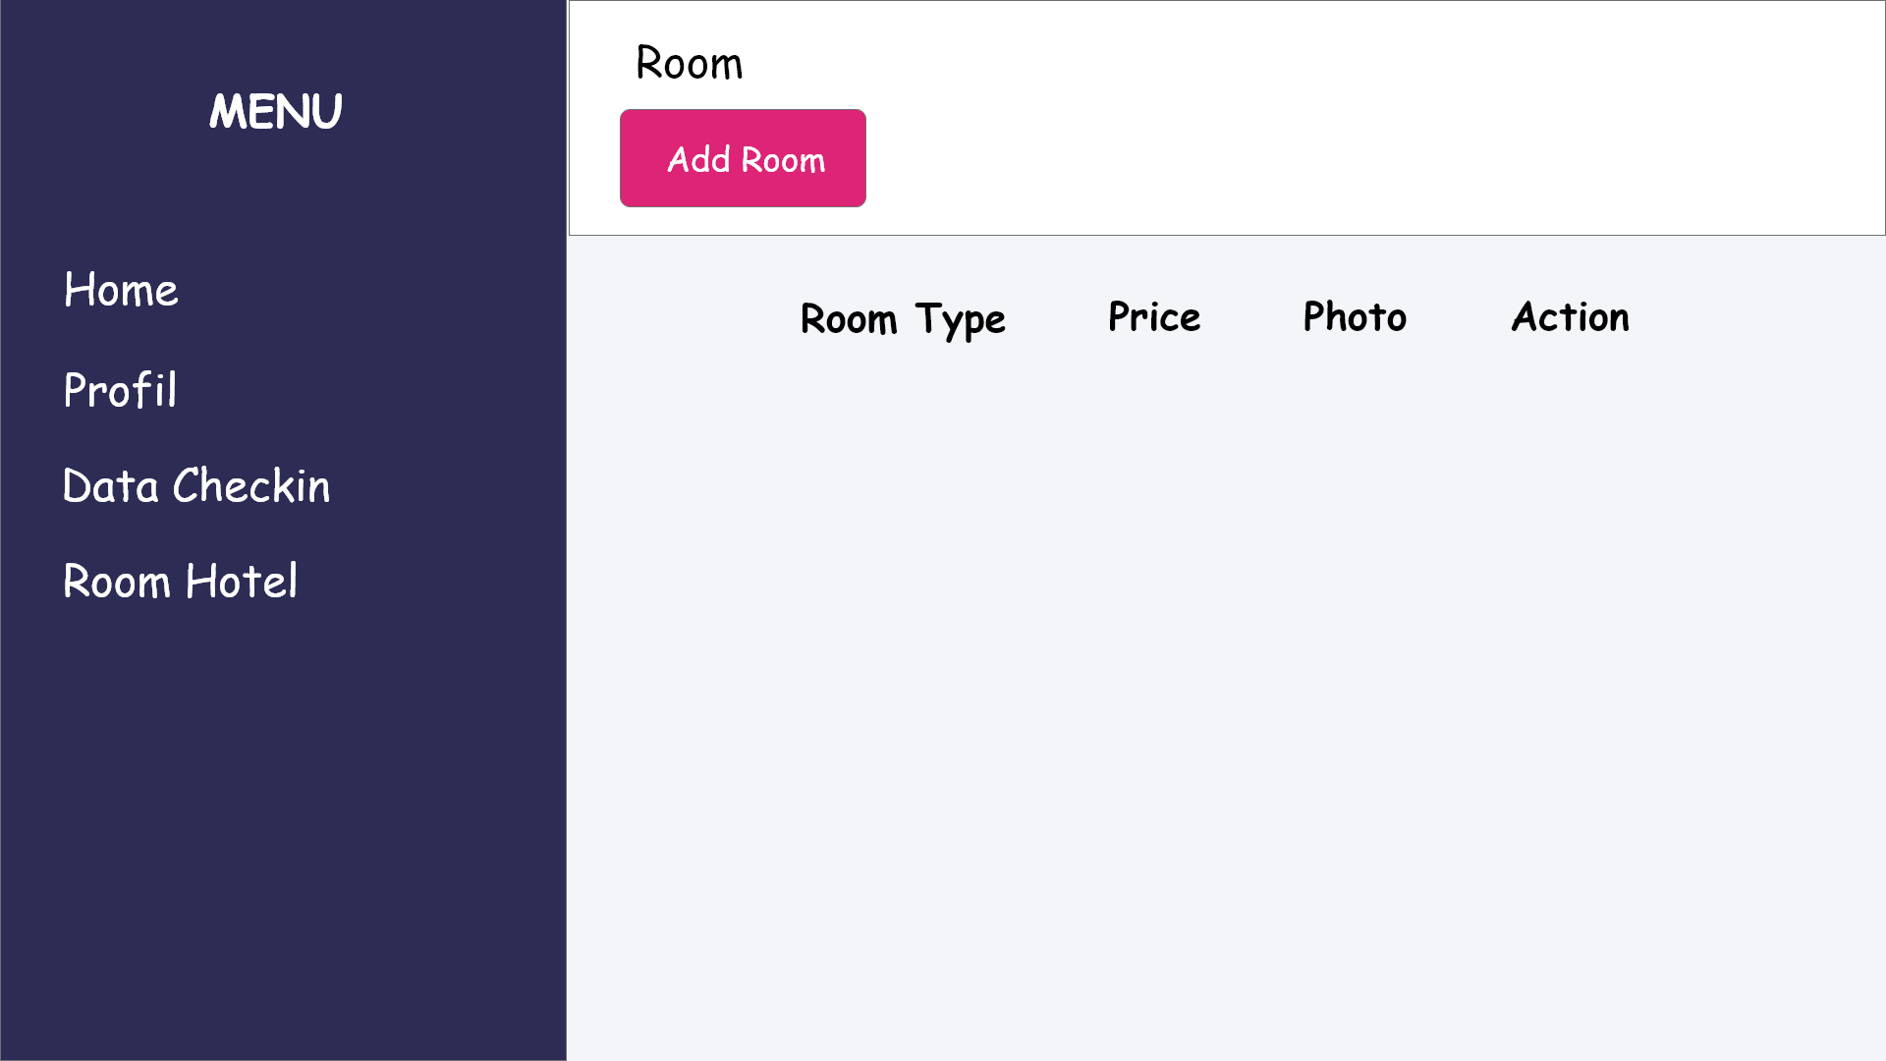
Infographic Style
D
Option A
You can simply impress your audience and add a unique zing and appeal to your Presentations.
A
Option B
You can simply impress your audience and add a unique zing and appeal to your Presentations.
Option C
You can simply impress your audience and add a unique zing and appeal to your Presentations.
Option D
You can simply impress your audience and add a unique zing and appeal to your Presentations.
C
B
I hope and I believe that this Template will your Time.
I hope and I believe that this Template will your Time.
I hope and I believe that this Template will your Time.
I hope and I believe that this Template will your Time.

Slide 23
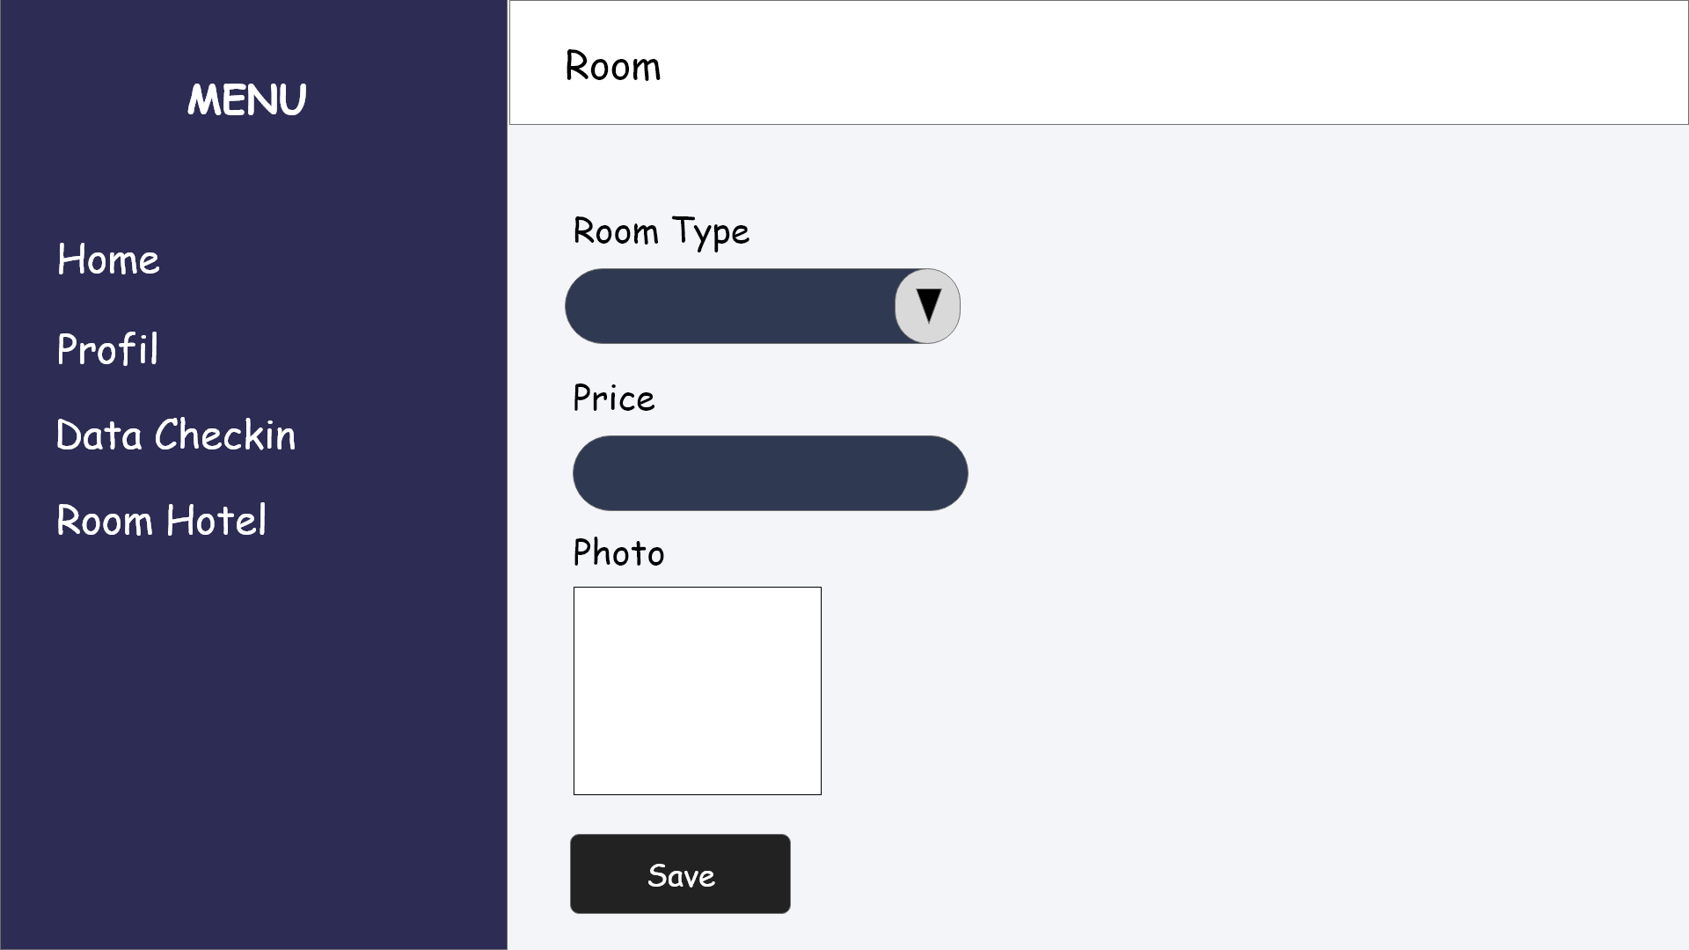
Infographic Style
Add Text
03
You can simply impress your audience and add a unique zing.
Add Text
You can simply impress your audience and add a unique zing.
Add Text
Add Text
You can simply impress your audience and add a unique zing.
01
You can simply impress your audience and add a unique zing.
04
02

Slide 24
Penjelasan Sistem
Terdiri dari 2 user, yaitu pengunjung dan admin. Halaman utama terdapat tampilan fasilitas dan food pada hotel tersebut. Dan ada system login, untuk masuk ke akun nya. Dari sisi pengunjung, dia bisa membooking room pada hotel tersebut. Pertama-tama memilih room yang ingin di book. Lalu jika sudah memilih room, pengunjung akan diminta input data booking, seperti nama, no telfon, dan lain lain. Data yang di isi oleh pengunjung akan masuk ke halaman data checkin pada admin. Dari sisi admin, dia bisa melihat profile, data checkin, dan room yang ada pada hotel tersebut. Di data checkin, akan terdapat daftar yang sedang pending. Data yang sedang pending itu adalah data yang di isi oleh pengunjung sebelum book. Selanjutnya admin akan menerima checkin tersebut,jika pengunjung sudah ada di hotel. Dan admin menginput Room no, dan berapa hari pengunjung membooking. Jika pengunjung sudah membayar, admin memberi proses checkout. Di room hotel, terdapat room yang ada pada hotel. Admin bisa menambah room,edit, dan hapus

Slide 25
Kesimpulan
WEB tersebut berfungsi untuk membooking hotel secara online

